Slide 1
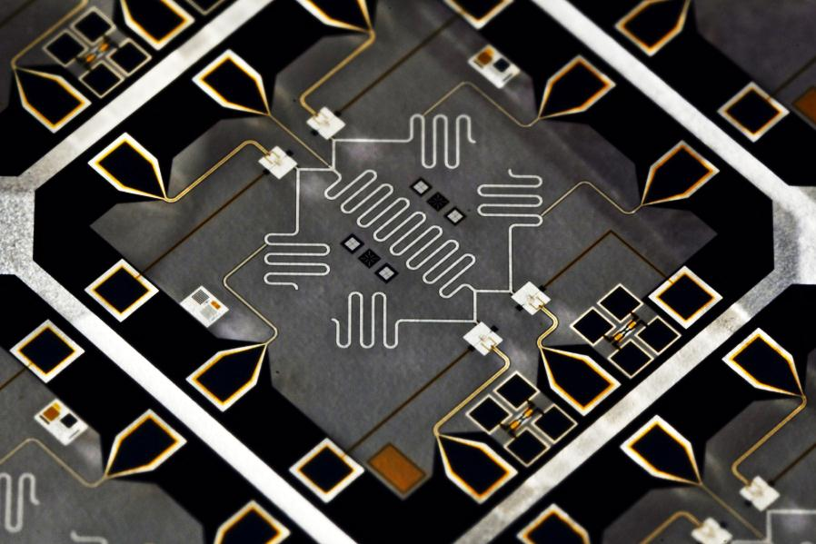
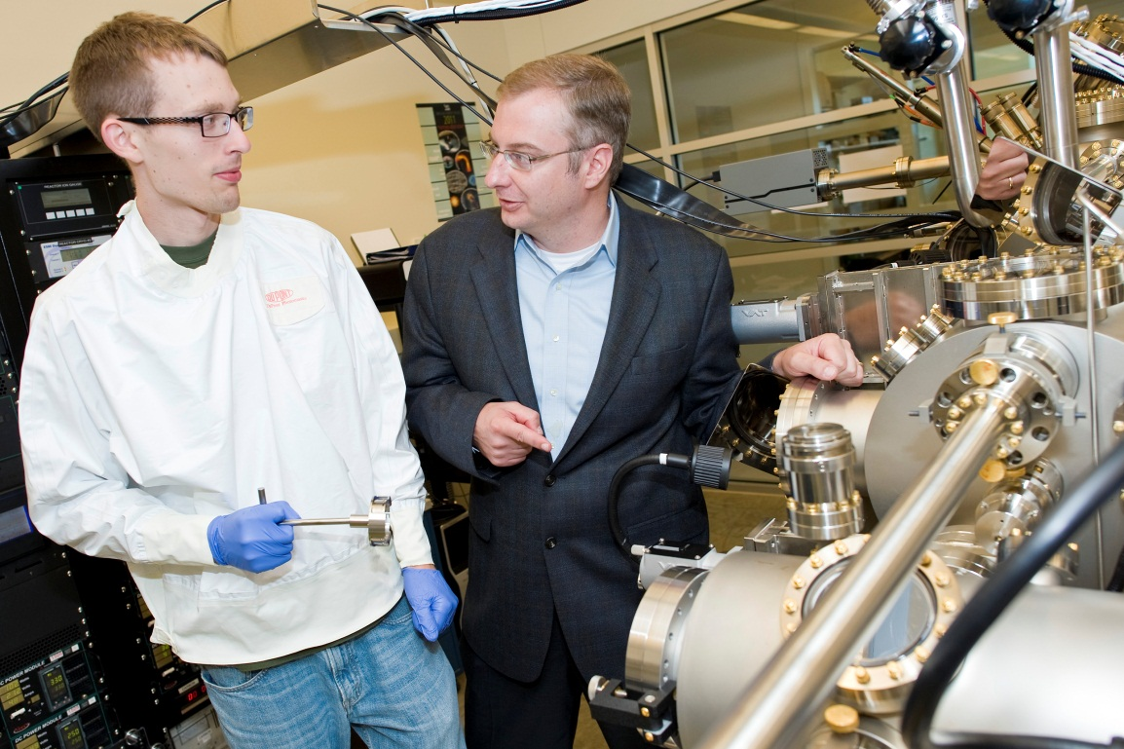
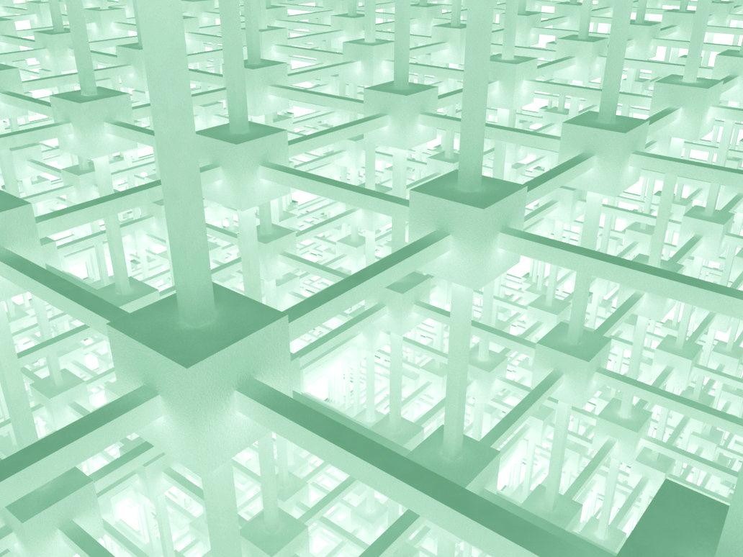
Post-Quantum Cryptography
Computer Security Division &
Applied and Computational Mathematics Division
Overview
Lattice-based Cryptography
Hash-based Signatures
Potential threat posed by quantum computers
Shor's algorithm breaks cryptosystems based on factoring and discrete logs (e.g., RSA, Diffie-Hellman, DSA over finite fields, elliptic curve)
Could quantum computers solve other hard problems?
Will large-scale quantum computers ever exist?
Recent estimates of fifteen to twenty years
Post-quantum cryptosystems
Based on lattices, codes, multivariate quadratic equations
Public-key cryptosystems (encryption, key establishment, digital signatures)
NTRUEncrypt: seems pretty good (fast, has reasonable key sizes, security is related to problems involving ideal lattices)
NTRUSign: was broken in the past, has been patched, seems ok now?
Theoretical work: cryptosystems and signature schemes with provable security based on the worst-case hardness of problems involving (ideal) lattices
Supports the design of NTRUEncrypt, but suggests modifications to NTRUSign (which would make it less efficient)
Questions: Can we get better lattice-based signatures?
Can we get reliable, quantitative estimates of security?
Performance of lattice basis reduction algorithms?
Are ideal lattices any less secure than general lattices?
Hash-based signature schemes
Stateful signatures (Lamport-Merkle)
Well-studied
Security relies on one-way function (e.g. hash function)
Based on one time signatures and Merkle trees
Only for limited applications, such as code signing
Stateless signatures
No state to manage – fits standard API’s
SPHINCS
Questions: Is it possible to reduce the signature size of Lamport-Merkle?
Quantum Computation
McEliece and Code-based Cryptosystems
Multivariate Cryptosystems
Quantum algorithms
Quantum computers achieve exponential speedups on certain problems (e.g., hidden subgroup problems)
And polynomial speedups on many more problems (esp. oracle problems, e.g., Grover search, element distinctness)
Could there be more exponential speedups?
Large-scale quantum computers
Fault-tolerant quantum computation is possible in theory
But current experimental implementations still have difficulty in achieving low error rates, and scaling up to large numbers of qubits
Need to move from individual components to complete systems
Need a lot of gates and qubits to beat a classical computer (b/c of fault tolerance overhead, and b/c today's classical computers are so good)
Based on the hardness of decoding random linear codes
McEliece cryptosystem
Well-studied, and seems very secure, but has giant keys
Can we live with giant keys?
Newer schemes
Reduce the key size by adding more structure
But security is not as well understood? (e.g., attacks using Grobner basis algorithms)
Questions: Can we develop more efficient and secure signature schemes than the CFS signature scheme?
Based on the hardness of solving random systems of multivariate quadratic equations with respect to the isomorphism of polynomials problem
Build a system of equations that contains a “trapdoor”
Small-field schemes (e.g., unbalanced oil-vinegar)
Big-field schemes (e.g., HFE-, pSFLASH)
Caution: several schemes have been broken using differential attacks (e.g., SFLASH)
Questions: Can we develop a framework for useful security arguments?
Can we develop efficient and secure encryption schemes?
Standardization Timeline
Evaluation Criteria
Research Publications
NIST is calling for quantum-resistant cryptographic algorithms for new public-key crypto standards
Digital Signatures, and Encryption/Key-establishment
Aug 2016 – Draft Call For Proposals released for public comment
Nov 2016 – Formal Call For Proposals finalized
Nov 2017 – Deadline for PQC submissions
April 2018 - Workshop
3-5 years – Analysis/Evaluation phase
2 years later – Draft Standards ready (2023-2025)
Security
Security definitions (IND-CCA2, EUF-CMA, CK)
Quantum/classical algorithm complexity
Security proofs
Cost
Computational efficiency (hardware/software)
Memory requirements (parameter and key sizes)
Algorithm and implementation characteristics
Ease of implementation on variety of platforms
Parallelizable, resistant to side-channel attack
How does it fit into exsisting protocols (e.g. TLS, IKE)
Y. K. Liu, Privacy Amplification in the Isolated Qubits Model
Y.K. Liu, Tamper-Resistant Cryptographic Hardware in the Isolated Qubits Model
D. Moody, R. Perlner, Vulnerabilities of “McEliece in the World of Escher”
D. Moody, R. Perlner, D. Smith-Tone, Attack on the Cubic ABC Simple Matrix Multivariate Encryption Scheme
R. Perlner, Optimizing Information Set Decoding Algorithms to Attack Cyclosymmetric MDPC codes
R. Perlner, D. Smith-Tone, Security Analysis and Key Modification for ZHFE
D. Smith-Tone, R. Cartor, R. Gipson, On the Differential Security of the HFEv- Signature Primitive
pqc@nist.gov

